Slide 1

Political Economy Analysis in the field:
The Development Entrepreneurship Approach
PPD Global Workshop, Frankfurt
6th March 2014

Slide 2
Political Economy Analysis in the field: The Development Entrepreneurship Approach
Introducing the Development Entrepreneurship (DE) Approach
Implementation of the DE Program in Bangladesh
Case Study: Use of PPD in the ICT Sector Intervention

Slide 3
Traditional approach and political Economy-based approach
Traditional Approach
Political Economy Approach
Donors give advice on what “should” be done
No consideration of the constraints and opportunities due to the political environment
Donors are encouraged to find not only what can be done, but also how it can be done
Navigate the political landscape to reach the goal

Slide 4
Thinking politically about development
Politics matters, but technical, administrative and practical components must also be in place for positive outcomes to occur
Agency matters: structural/cultural/institutional factors do not automatically determine behaviour; rather there is room for maneuver
Leadership matters, but leaders should be understood not as solitary actors; instead, leadership is seen as the process of mobilizing people and resources
Coalitions play important roles in impeding or promoting reform, and must be considered as a central part of the political landscape

Slide 5
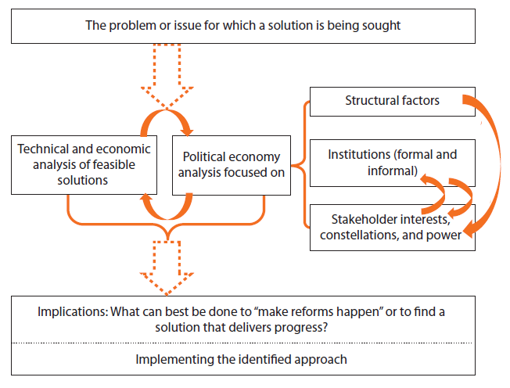
Thinking politically about development

Slide 6
The Development Entrepreneurship Approach
Technical analysis, political economy analysis and political action are integrated in an iterative search process for breakthroughs
The target is technically sound, politically feasible reforms
Use of reform conjunctures: unforeseen events or circumstances that render the reform target politically feasible
Identification of development entrepreneurs, who are willing to strategically engage themselves in political networking and bargaining, in pursuit of reforms

Slide 7
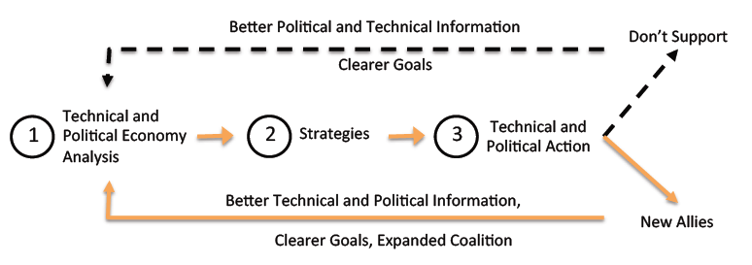
The Development Entrepreneurship Approach

Slide 8
Political Economy Analysis in the field: The Development Entrepreneurship Approach
Introducing political economy analysis and the Development Entrepreneurship (DE) Approach
The DE Program in Bangladesh
Case Study: Use of PPD in the ICT Sector Intervention
Tools and techniques for facilitating iterative, PEA-based programming for policy reforms

Slide 9
Target sectors under the DE Program
The program utilizes a flexible, iterative approach, seeking business-enabling policy reforms to remove binding constraints in high-potential sectors
Sector | Constraint | Key Actors
Leather | Lack of environmental compliance | Leather associations, exporters and domestic market suppliers, Ministry of Industries
ICT | Lack of competition in bandwidth markets | Submarine cable operator, national backhaul operators, mobile telcos, telecom regulator
Energy | Lack of a policy for a sustainable energy basket | Private power generation companies, energy regulator,

Slide 10
Application of DE Model in Bangladesh
New info/critical junctures
Situation Analysis
Interventions
Institutional Analysis
Market Analysis
Analysis of Key Players
Procedural Innovations
Coalition-building activities
Forward-looking interventions
Strategies implemented:
Use of flexibility in
  selecting reform champions/supporters, including players not directly involved in the sector
  Highlighting issues that interest elites, to increase their participation and interest
  Iteration in problem solving, finding the path of least resistance
Addressing collective action problems: where rational pursuit of narrow, individual interests results in collective irrationality
  Presenting the case to highly influential sector leaders, and relying on bandwagon effect, as others follow
  Broadening the network for monitoring of compliance
Positioning TAF as a neutral broker between opposing parties, and building trust gradually through incremental, informal commitments, finally leading to enforceable contracts/institutions

Slide 11
Use of PPD in the DE Program
In the context of the DE Program, PPD is used to:
  Identify and incorporate new actors into the reform coalition
  Focus the debate on issues that had not been discussed previously
  Attract the attention of political elites towards necessary reforms
  Deepen and strengthen relationships among the reform coalition for future purposes

Slide 12
Overall strategy for PPD
Identify relevant interest groups, and their incentives
Focus discussion on a small number of issues, aiming to promote better understanding of the problem among all actors
Involve highly regarded political/technical elites to use their political capital to build momentum for reform, and to act as trusted, honest brokers
Promote a shift away from clientalist arrangements towards an analytical, evidence-based approach to problem solving
Utilize regional experience to guide progress and identify opportunities

Slide 13
Political Economy Analysis in the field: The Development Entrepreneurship Approach
Introducing political economy analysis and the Development Entrepreneurship (DE) Approach
The DE Program in Bangladesh
Case Study: Use of PPD in the ICT Sector Intervention

Slide 14
Use of Theory of Change framework in political economy-based interventions
The Theory of Change (TOC) framework is intended as an alternative to the “black box” approach, in which important assumptions, and causal factors are left undocumented
Questions addressed by the TOC:
  What is the problem being addressed?
  What outcomes does the program aim to achieve?
  What intermediate steps lead to those outcomes?
  What assumptions are associated with each link in the causal chain?

Slide 15
Monitoring and Evaluation of political economy interventions using the TOC
The Theory of Change document is used to record how the reform evolves as new information/actors/conjunctures arise
A separate document is used to record changes in the TOC, with justifications for the changes
Components of the TOC:
Current Scenario/Problem Statement
Analysis of Key Dynamics
Interventions/Strategies
Intermediate Outcomes
Ultimate Outcome(s)

Slide 16
Theory of Change for the ICT sector intervention
Ultimate Outcome
Intermediate Outcomes
Increase broadband penetration beyond current level of <1%, thus creating employment and increasing competitiveness
Encourage private sector investment submarine cable
Current Scenario
Political Economy-based interventions
Lack of competition in int’l bandwidth and nat’l backhaul networks
Increased competition in backhaul segment (Open license policy)
Action research
Meetings with elites
Attracting investors
Regional experience
PPDs

Slide 17
Structure of the ICT Sector
ISPs
Terrestrial Cables
Landing Station
Int’l Gateway
Submarine cable
Nat’l Backhaul Network
ISPs
Lack of competition and an uncertain investment climate in the submarine cable and backhaul sectors is constraining the ICT industry
Currently, only a single government-owned submarine cable is in operation
Only 3 backhaul connectivity providers in operation, one of which is historically government-owned
Corporate Clients

Slide 18
Contextual Issues in ICT Sector PPD
What is the right time to organize a PPD event? How frequently should such events be held?
  First PPD event (April 2013) was held to generate awareness regarding competition issues in bandwidth and backhaul
  During second PPD event (August 2013), policy options were presented and discussed in the context of available evidence
The PPD concept was absent from the ICT sector in Bangladesh:
  multiple stakeholders with varying interests and incentives, who had never formally discussed sector-level issues
  Policymakers including Secretary of Bangladesh Telecom Regulatory Commission, ICT Minister, etc., had not consulted private sector in designing policy

Slide 19
Contextual Issues in ICT Sector PPD
The PPDs focus on a limited number of issues, but they are highly complex and political
  The goal is to reform the competitive framework in the sector, i.e., to change the rules of the game
Preparation for PPD involves not only identification of key issues, but also finding the key political insiders, and gaining their confidence
Informal, one-on-one interactions were used to approach relevant stakeholders and invite them to participate in the PPD
  No formal working groups
The players involved are highly knowledgeable and have access to necessary information
  Knowledge dissemination is not a key goal of the PPD; instead, it is a tool to align political incentives with the reform agenda

Slide 20
Highlights of PPD techniques in the political economy context
Management of two fundamental pillars is vital to the success of the reform initiative:
Use of flexibility to respond to the interests of stakeholders:
  Important to build stakeholders’ trust in the iterative reform process, so they do not see changes in strategy as failures
Allowing the agenda to evolve, but retaining the “key log” as the primary focus
  Incorporate stakeholders’ “pet” issues, while also keeping the dialogue focused on the actual binding constraints
  Find “compromise points” that facilitate negotiations

Slide 21
Roles of relevant stakeholders
The Asia Foundation:
The Asia Foundation designs the overall strategy for reform, facilitates networking, and steers the reform
Interests of core reform coalition (with room for negotiation)
Understanding of political economy is at the heart of this role
The Asia Foundation analyzes, anticipates and guides the interests of relevant stakeholders, with the goal of aligning them, so that they are focused on the core reform agenda
Interests of broader coalition
Interests of government
Core Reform Agenda
Interests of industry/academia

Slide 22
Roles of relevant stakeholders
Development entrepreneur:
Functions as the contact point between all involved stakeholders
Identifies potential reform partners and incorporates them in the core coalition
Provides inside knowledge of the problem/sector being addressed
Influential elites/reform champions/political insiders:
Provide the initial investment of political capital that is required to affirm the legitimacy of the reform
Allow access to incumbent policymakers and regulators
May be called upon to act as neutral brokers between the interests of different stakeholders
Academic experts/industry leaders:
Provide guidance on alternative technical solutions available
Complete action research when called for to support and inform policy discussions

Slide 23
Roles of relevant stakeholders
Media partners:
Actively involved in promoting reform, by following up on commitments made, reporting of progress, providing supporting data and qualitative information support to facilitate attribution of reforms (during M&E)

Slide 24
Roadmap for political economy-based PPDs
Preparing for PPD
During PPD
Follow-up after PPD
Utilize problem-driven PEA to find binding constraints in the sector
Stakeholder mapping and identification of stakeholders’ interests and incentives
Informal, one-on-one engagements with potential participants, to increase awareness and support of issues
Use of flexibility and iteration in selecting issues to
Identify influential elite/reform champion who can ensure legitimacy of the PPD

Slide 25
Roadmap for political economy-based PPDs
Preparing for PPD
During PPD
Follow-up after PPD
Manage differing stakeholder interests effectively, and keep the dialogue focused on the key binding constraints
Share relevant action research to ground the discussion in evidence
Utilize regional experience from comparable countries to influence regulators/policymakers, and counter clientalist practices

Slide 26
Roadmap for political economy-based PPDs
Preparing for PPD
During PPD
Follow-up after PPD
Assessment of new players as potential reform partners
Small, informal meetings with selected members of PPDs, to discuss how issues raised at the PPD affect the reform project
If necessary, adjustments to intermediate outcomes/interventions are made in the TOC

Slide 27
Identifying binding constraints
Three approaches to sectoral reforms:
“Any reform is good, and the more reforms the better”
  Practical approach, but may be based on faulty economic logic
  Reforms will not get the biggest “bang for the buck”, and may fail to make a lasting impact
“Shoot the biggest elephant” (aka concertina method)
  Target only the “largest” market distortions: most people affected/largest monetary loss/most obvious inefficiencies
  Likely to appeal to politicians and business owners
  Does not recognize interaction effects: e.g. reducing excessive taxation on mining may lead to increased investment, but also greater environmental damage
Focus on a small number of binding constraints, based on sound analysis
  Binding constraints may not be obvious, even to some business insiders
  Their effects may not be immediately quantifiable, but in the long run, they have the greatest effect on the industry
Notes:
In welfare economics, the Theory of the Second Best states that when there is more than one distortion/inefficiency in a market, the second-best solution (where the first-best refers to removal of all distortions) may involve changing variables away from the values that are usually assumed to be optimal. This underlies the criticism of approaches 1 and 2 in the slide above.
Further reading:
Hausmann, Rodrik, Velasco. Getting the Diagnosis Right. 2006
http://www.imf.org/external/pubs/ft/fandd/2006/03/hausmann.htm

Slide 28
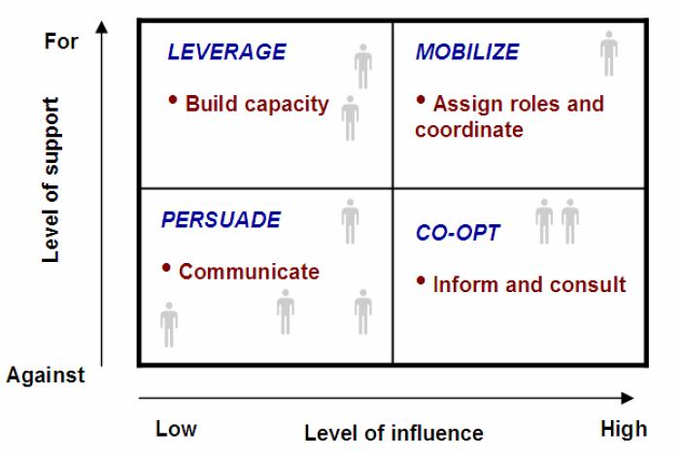
Different types of champions may need to be handled differently
For example, stakeholder analysis may identifies SMEs as pro-dialogue but relatively powerless and labor unions as anti-dialogue and powerful
In this case, quite different champions may need to be identified to leverage the former and co-opt the latter

Slide 29
Lessons learned
History matters: without a deep understanding of the history of reform in a sector, it is impossible to find breakthroughs to take it forward
  Involvement of veterans (Dr. Jamilur Reza) in the ICT sector reform coalition provided in-depth knowledge of previous reform attempts, and reasons for their failure
The need for development entrepreneurs: facilitation, cajoling and exploration by locally embedded actors is the key to transforming policy goals to realities on the ground
Learning from failure: practitioners must have the opportunity to explore ideas and avenues for reform, and to take risks that may lead to failure. When failures do occur, they must be taken as learning opportunities
Reform of incentives and systems may be a more important goal for development work than service delivery. Reform unleashes the power of local actors to deliver services in a sustainable way.
Flexibility of programming is necessary to allow practitioners to explore alternatives and find entry points. Reforms will generally not have a clear path from the outset.

Slide 30
Further Readings
Department for International Development (DFID). Political Economy Analysis How To Note. 2009
  http://www.odi.org.uk/sites/odi.org.uk/files/odi-assets/events-documents/3501.pdf
DFID. Tools for Political Economy Analysis. 2009.
  http://www.google.com/url?sa=t&rct=j&q=&esrc=s&source=web&cd=1&cad=rja&ved=0CCUQFjAA&url=http%3A%2F%2Fcapacity4dev.ec.europa.eu%2Fsystem%2Ffiles%2Ffile%2F16%2F07%2F2012_-_1626%2F3.htn_annex_a_tools.pdf&ei=ODoMU-foGoflrAel_QE&usg=AFQjCNEOXb5EVCu3tvj03FlhZPrtsCNENg&sig2=Vd_KLMgiEK6QdtZNW7LehQ&bvm=bv.61725948,d.bmk
Development Leadership Program (DLP). Politics, Leadership and Coalitions in Development. 2011
  http://www.dlprog.org/ftp/view/Public%20Folder/Politics,%20Leadership%20and%20Coalitions%20in%20Development%20-%20Findings,%20insights%20and%20guidance.pdf
The Asia Foundation. Built on Dreams, Grounded in Reality: Economic Policy Reform in the Philippines. 2011
  http://asiafoundation.org/resources/pdfs/FRONT.pdf
DFID, World Bank, IFC, OECD. The PPD Handbook. 2006
  http://www.publicprivatedialogue.org/papers/PPD%20handbook.pdf

Slide 31
Thank You

